Slide 1

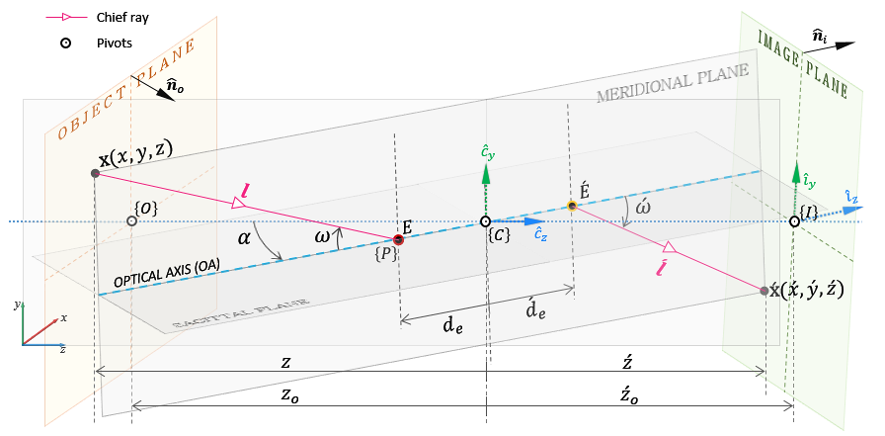
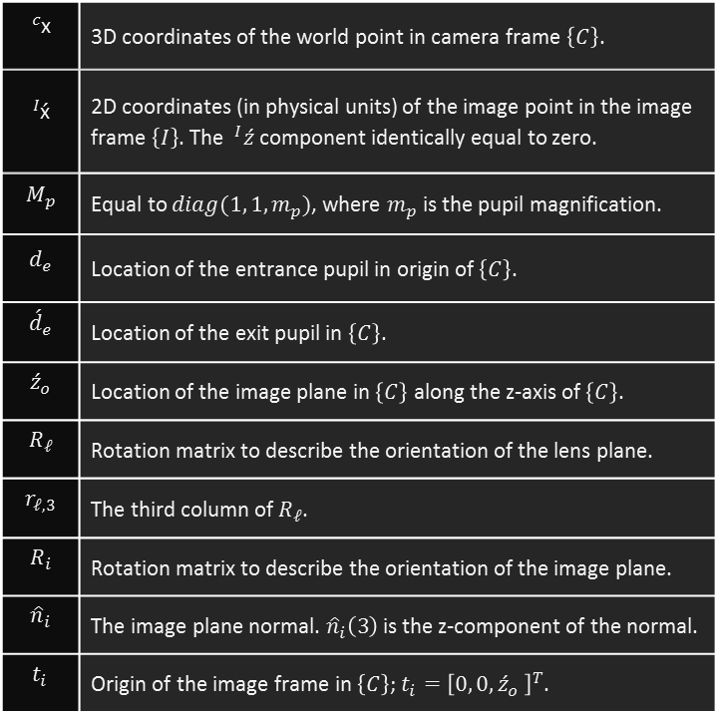
Properties of geometric image under lens and sensor rotation
Equation:
$$\begin{aligned}{}_{ }^{I}{\acute{\text{x}}}=&{R_{i}}^{T}\left({\acute{d}}_{e} r_{𝓁,3}−t_{i}\right)&+\frac{\left({\hat{n}}_{i}\left(3\right){\acute{z}}_{o}−{\acute{d}}_{e}{\hat{n}}_{i}^{T} r_{𝓁,3}\right)}{{\hat{n}}_{i}^{T}{}_{ }^{ }{R_{𝓁}}M_{p}{R_{𝓁}}^{T}\left({}_{ }^{c}{\text{x}}−d_{e} r_{𝓁,3}\right)}{}_{ }^{ }{{R_{i}}^{T}R_{𝓁}}M_{p}{R_{𝓁}}^{T}\left({}_{ }^{c}{\text{x}}−d_{e} r_{𝓁,3}\right) \\ \end{aligned}$$
$${}_{ }^{c}{\text{x}}$$ | 3D coordinates of the world point in camera frame $\left\{C\right\}$.
$${}_{ }^{I}{\acute{\text{x}}}$$ | 2D coordinates (in physical units) of the image point in the image frame $\left\{I\right\}$. The $^{I}\acute{z}$ component identically equal to zero.
$$M_{p}$$ | Equal to $diag(1, 1, m_{p})$, where $m_{p}$ is the pupil magnification.
$$d_{e}$$ | Location of the entrance pupil in origin of $\left\{C\right\}$.
$${\acute{d}}_{e}$$ | Location of the exit pupil in $\left\{C\right\}$.
$${\acute{z}}_{o}$$ | Location of the image plane in $\left\{C\right\}$ along the z-axis of $\left\{C\right\}$.
$$R_{𝓁}$$ | Rotation matrix to describe the orientation of the lens plane.
$$r_{𝓁,3}$$ | The third column of $R_{𝓁}$.
$$R_{i}$$ | Rotation matrix to describe the orientation of the image plane.
$${\hat{n}}_{i}$$ | The image plane normal. ${\hat{n}}_{i}\left(3\right)$ is the z-component of the normal.
$$t_{i}$$ | Origin of the image frame in $\left\{C\right\}$; $t_{i}={\left[0, 0,{\acute{z}}_{o} \right]}^{T}$.

Slide 2
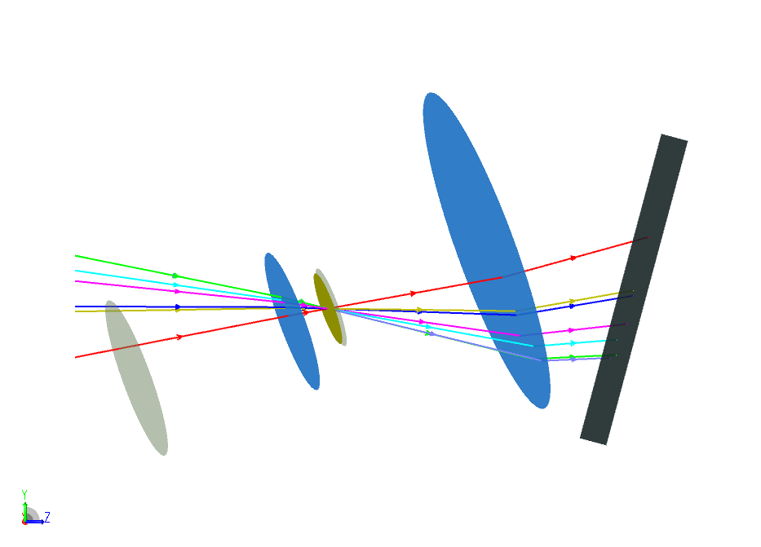
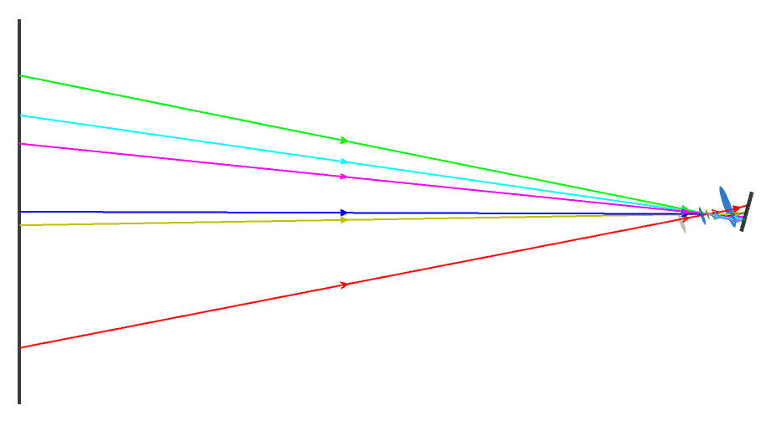
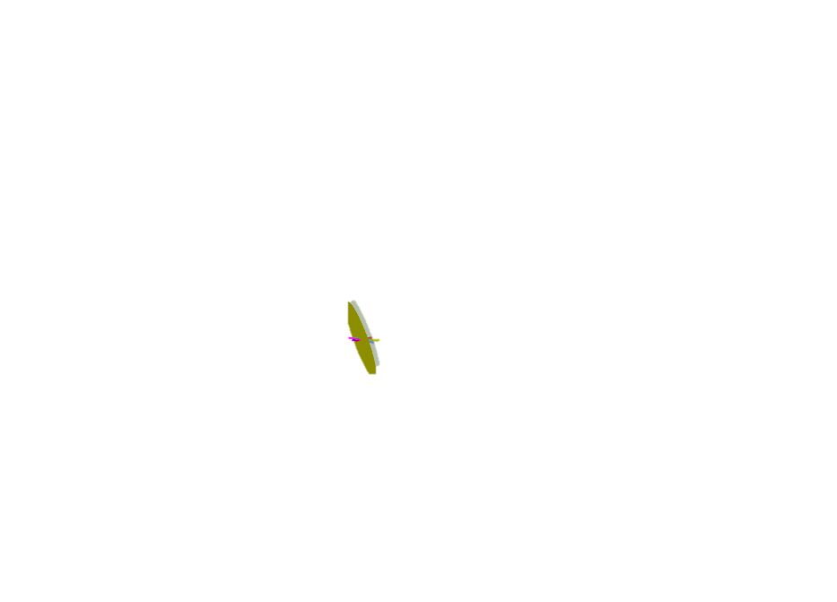
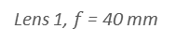
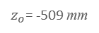

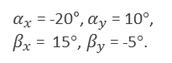
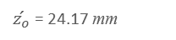
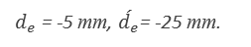
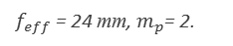
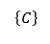
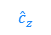
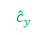
Properties of geometric image under lens and sensor rotation
Equation:
$$\begin{aligned}{}_{ }^{I}{\acute{\text{x}}}=&{R_{i}}^{T}\left({\acute{d}}_{e} r_{𝓁,3}−t_{i}\right)&+\frac{\left({\hat{n}}_{i}\left(3\right){\acute{z}}_{o}−{\acute{d}}_{e}{\hat{n}}_{i}^{T} r_{𝓁,3}\right)}{{\hat{n}}_{i}^{T}{}_{ }^{ }{R_{𝓁}}M_{p}{R_{𝓁}}^{T}\left({}_{ }^{c}{\text{x}}−d_{e} r_{𝓁,3}\right)}{}_{ }^{ }{{R_{i}}^{T}R_{𝓁}}M_{p}{R_{𝓁}}^{T}\left({}_{ }^{c}{\text{x}}−d_{e} r_{𝓁,3}\right) \\ \end{aligned}$$
Verification: Compare numerically computed values against Zemax ray-traced values
Setup:
Paraxial double lens composed of two paraxial surfaces. Effective focal length is 24 mm.
Pupil magnification = 2
Lens pivot = 5 mm from the ENPP, towards the image plane.
Rotations about x- and y-axes of lens and sensor chosen arbitrarily.
$f_{eff}$ = 24 mm, $m_{p}$= 2.
Lens 2, $f$ = 30 mm
$d_{e}$ = -5 mm, $\acute{d_{e}}$= -25 mm.
Object plane
$α_{x}$ = -20°, $α_{y}$ = 10°,
$β_{x}$ = 15°, $β_{y}$ = -5°.
Image plane
Lens 1, $f$ = 40 mm
$${\hat{c}}_{y}$$
Optical axis
Stop
Chief rays
$${\hat{c}}_{z}$$
$$\left\{C\right\}$$
$z_{o}$= -509 mm
y
Entrance pupil
x
z
Exit pupil
$\acute{z_{o}}$ = 24.17 mm
Pivots

Slide 3
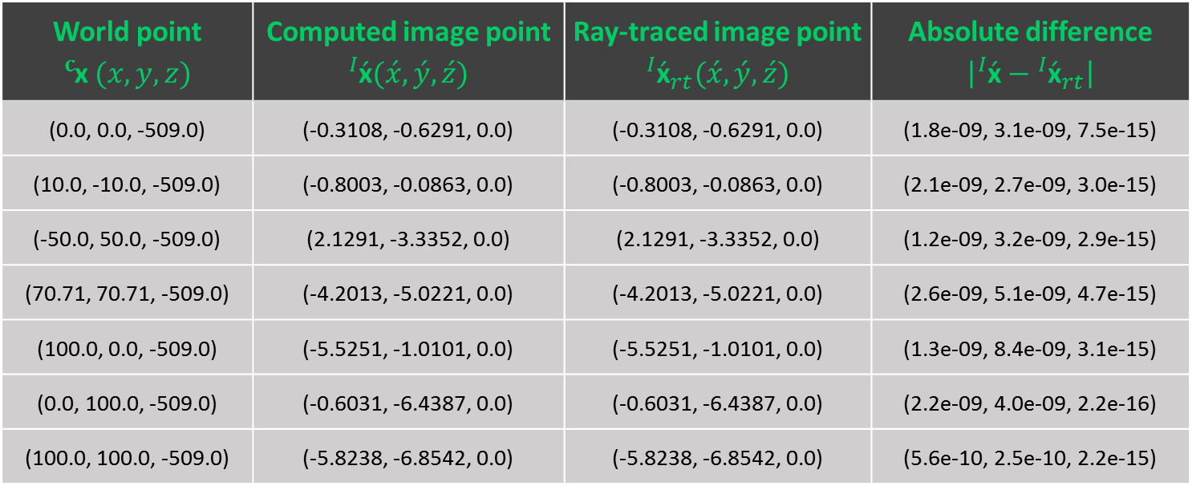
Properties of geometric image under lens and sensor rotation
Equation:
$$\begin{aligned}{}_{ }^{I}{\acute{\text{x}}}=&{R_{i}}^{T}\left({\acute{d}}_{e} r_{𝓁,3}−t_{i}\right)&+\frac{\left({\hat{n}}_{i}\left(3\right){\acute{z}}_{o}−{\acute{d}}_{e}{\hat{n}}_{i}^{T} r_{𝓁,3}\right)}{{\hat{n}}_{i}^{T}{}_{ }^{ }{R_{𝓁}}M_{p}{R_{𝓁}}^{T}\left({}_{ }^{c}{\text{x}}−d_{e} r_{𝓁,3}\right)}{}_{ }^{ }{{R_{i}}^{T}R_{𝓁}}M_{p}{R_{𝓁}}^{T}\left({}_{ }^{c}{\text{x}}−d_{e} r_{𝓁,3}\right) \\ \end{aligned}$$
Verification: Compare numerically computed values against Zemax ray-traced values
World point ${}_{ }^{c}{\text{x}} (x, y, z)$ | Computed image point ${}_{ }^{I}{\acute{\text{x}}}(\acute{x}, \acute{y}, \acute{z})$ | Ray-traced image point ${{}_{ }^{I}{\acute{\text{x}}}}_{rt}(\acute{x}, \acute{y}, \acute{z})$ | Absolute difference $\left|{}_{ }^{I}{\acute{\text{x}}}−{{}_{ }^{I}{\acute{\text{x}}}}_{rt}\right|$
(0.0, 0.0, -509.0) | (-0.3108, -0.6291, 0.0) | (-0.3108, -0.6291, 0.0) | (1.8e-09, 3.1e-09, 7.5e-15)
(10.0, -10.0, -509.0) | (-0.8003, -0.0863, 0.0) | (-0.8003, -0.0863, 0.0) | (2.1e-09, 2.7e-09, 3.0e-15)
(-50.0, 50.0, -509.0) | (2.1291, -3.3352, 0.0) | (2.1291, -3.3352, 0.0) | (1.2e-09, 3.2e-09, 2.9e-15)
(70.71, 70.71, -509.0) | (-4.2013, -5.0221, 0.0) | (-4.2013, -5.0221, 0.0) | (2.6e-09, 5.1e-09, 4.7e-15)
(100.0, 0.0, -509.0) | (-5.5251, -1.0101, 0.0) | (-5.5251, -1.0101, 0.0) | (1.3e-09, 8.4e-09, 3.1e-15)
(0.0, 100.0, -509.0) | (-0.6031, -6.4387, 0.0) | (-0.6031, -6.4387, 0.0) | (2.2e-09, 4.0e-09, 2.2e-16)
(100.0, 100.0, -509.0) | (-5.8238, -6.8542, 0.0) | (-5.8238, -6.8542, 0.0) | (5.6e-10, 2.5e-10, 2.2e-15)

Slide 4
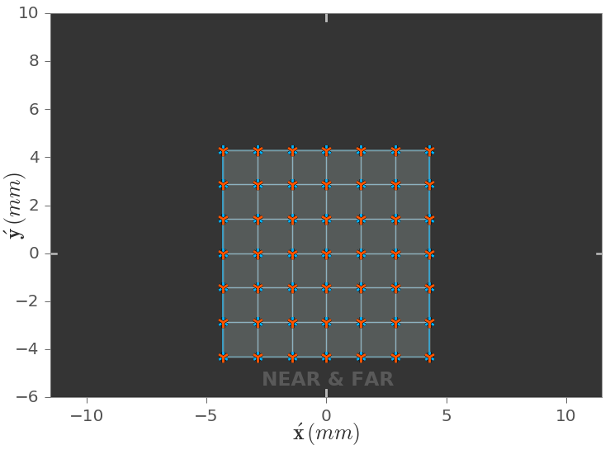
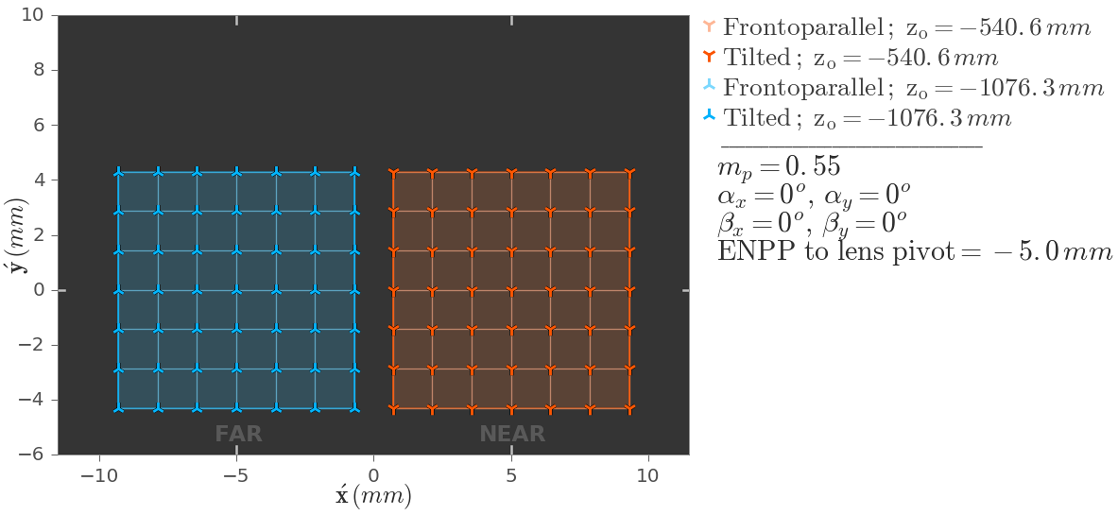
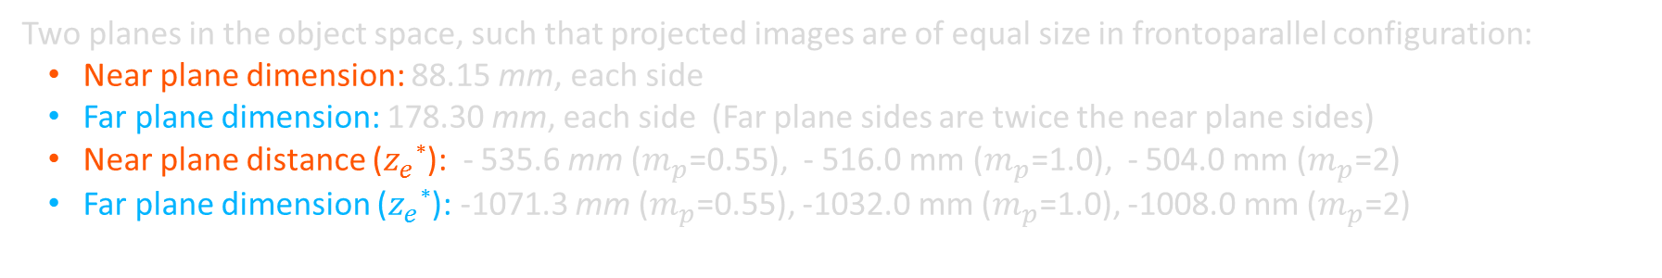
Geometric image under lens and sensor rotation
Setup of qualitative study:
Two planes in the object space, such that projected images are of equal size in frontoparallel configuration:
Near plane dimension: 88.15 mm, each side
Far plane dimension: 178.30 mm, each side (Far plane sides are twice the near plane sides)
Near plane distance ($z_{e}$*): - 535.6 mm ($m_{p}$=0.55), - 516.0 mm ($m_{p}$=1.0), - 504.0 mm ($m_{p}$=2)
Far plane dimension ($z_{e}$*): -1071.3 mm ($m_{p}$=0.55), -1032.0 mm ($m_{p}$=1.0), -1008.0 mm ($m_{p}$=2)
Coincident images of the two planes in frontoparallel configuration.
The images separated horizontally for visual clarity.
* $z_{e}$ is the object distance from the ENPP; $z_{o}=z_{e}+d_{e}$

Slide 5
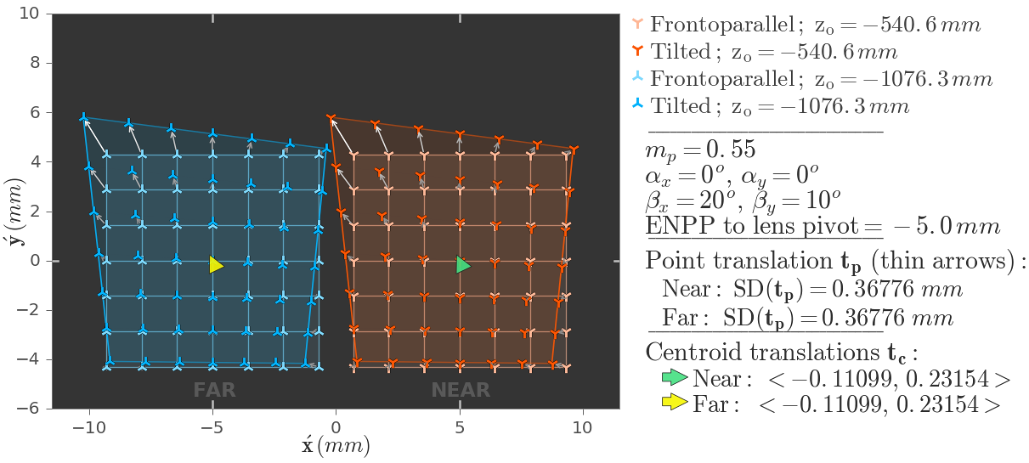
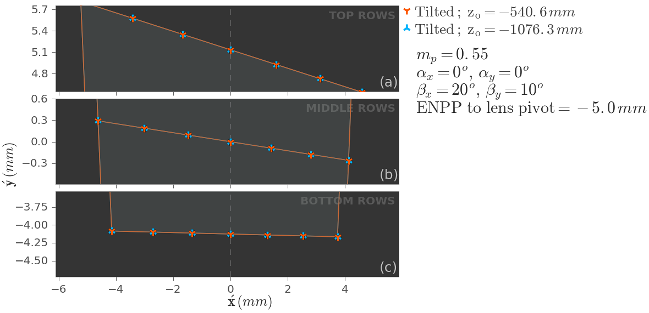
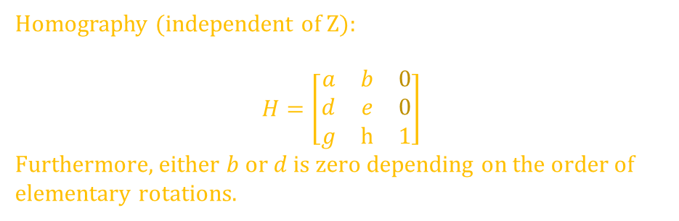
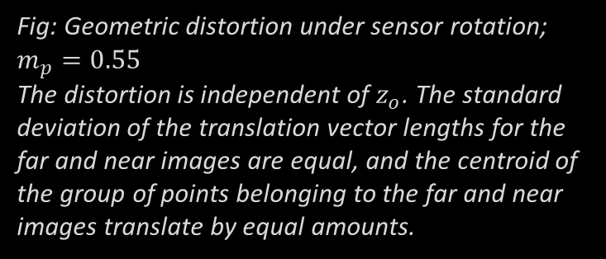
Geometric image under sensor rotation
Fig: Geometric distortion under sensor rotation; $m_{p}=0.55$
The distortion is independent of $z_{o}$. The standard deviation of the translation vector lengths for the far and near images are equal, and the centroid of the group of points belonging to the far and near images translate by equal amounts.
Fig: The top, middle and bottom rows of the grid of dots images of the two planes that are at different distances from the lens. The coincidence of the three rows implies that the distortion is independent of object distance. i.e. sensor rotation doesn’t introduce parallax.
Homography (independent of Z):
$$H=\left[\begin{matrix}a & b & 0 \\ d & e & 0 \\ g & h & 1\end{matrix}\right]$$
Furthermore, either $b$ or $d$ is zero depending on the order of elementary rotations.
Notes:
Other notes:
The homography is exactly the same for the corresponding points (before and after rotation) for the near and far image points.
Example homography (independent of Z):
$$H=\left[\begin{matrix}1.0154 & 0 & 0 \\ −0.0642 & 1.0642 & 0 \\ 0.0131 & −0.0253 & 1\end{matrix}\right]$$

Slide 6
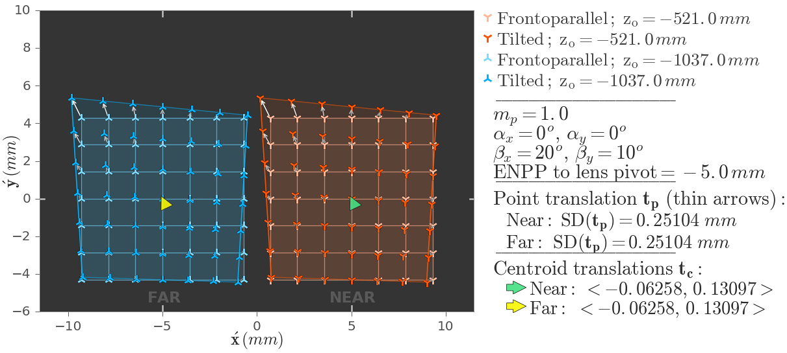
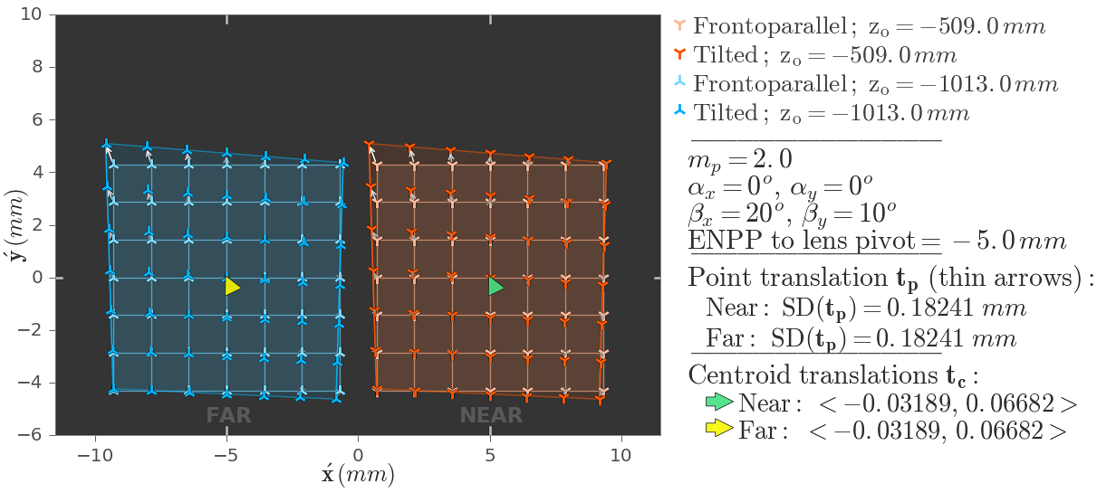
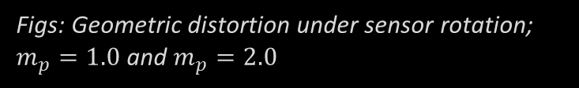
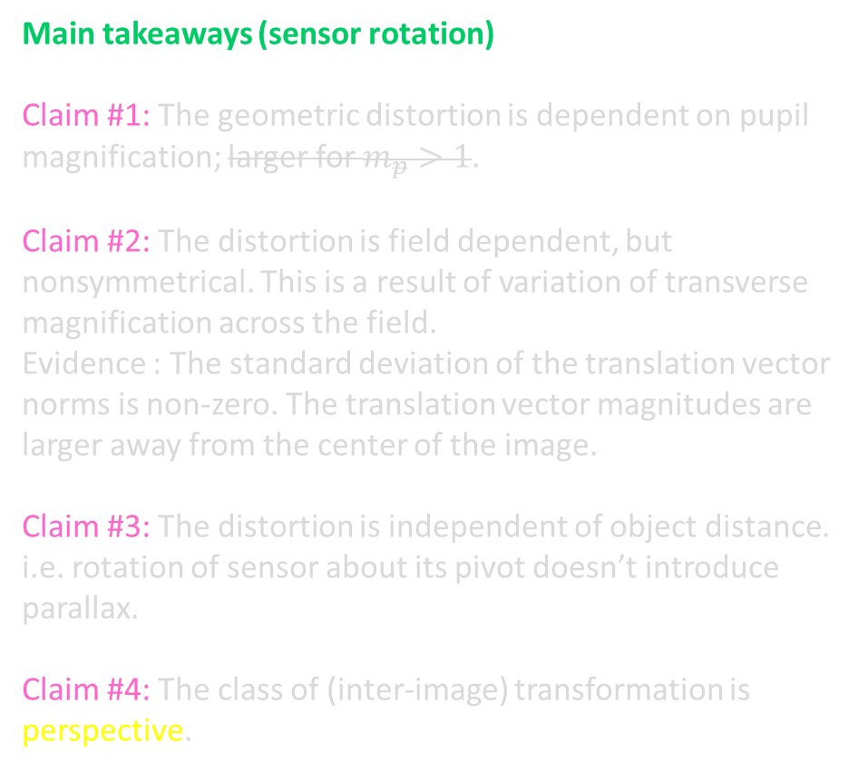
Geometric image under sensor rotation
Figs: Geometric distortion under sensor rotation; $m_{p}=1.0$ and $m_{p}=2.0$
Main takeaways (sensor rotation)
Claim #1: The geometric distortion is dependent on pupil magnification; larger for $m_{p}>1$.
Claim #2: The distortion is field dependent, but nonsymmetrical. This is a result of variation of transverse magnification across the field.
Evidence : The standard deviation of the translation vector norms is non-zero. The translation vector magnitudes are larger away from the center of the image.
Claim #3: The distortion is independent of object distance. i.e. rotation of sensor about its pivot doesn’t introduce parallax.
Claim #4: The class of (inter-image) transformation is perspective.
Notes:
Other notes:
The perspective transformation due to the sensor rotation is a “limited class” of perspective transformation in which the “translation components” are zero.

Slide 7
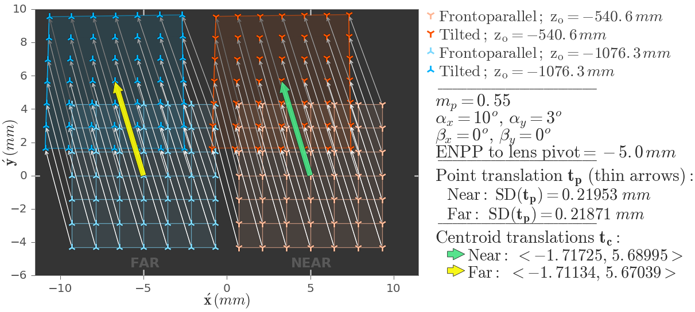
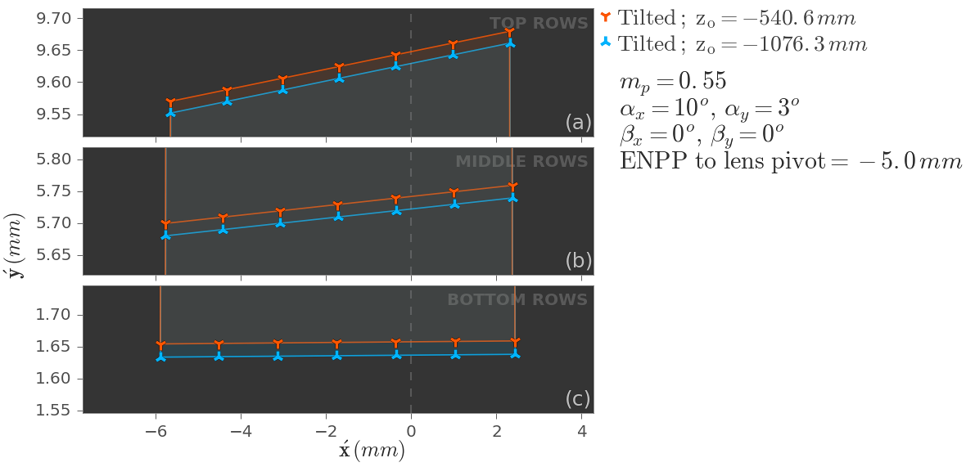
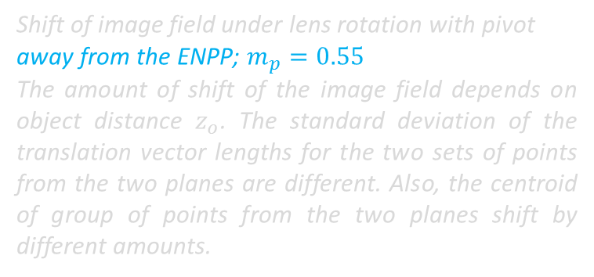
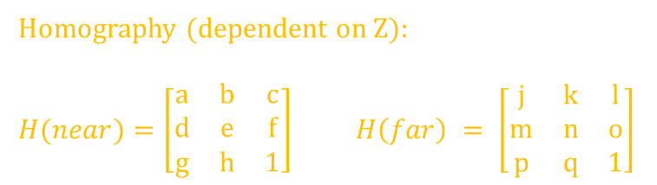
Geometric image under lens rotation. Pivot $≠$ ENPP
Shift of image field under lens rotation with pivot away from the ENPP; $m_{p}=0.55$
The amount of shift of the image field depends on object distance $z_{o}$. The standard deviation of the translation vector lengths for the two sets of points from the two planes are different. Also, the centroid of group of points from the two planes shift by different amounts.
The top, middle and bottom rows of the grid of dots images of the two planes. The difference in the shift of the three rows implies that the distortion is NOT independent of object distance. i.e. lens rotation away from the ENPP introduces parallax.
Homography (dependent on Z):
$H(near)=\left[\begin{matrix}a & b & c \\ d & e & f \\ g & h & 1\end{matrix}\right]$ $H\left(far\right) = \left[\begin{matrix}j & k & l \\ m & n & o \\ p & q & 1\end{matrix}\right]$
Notes:
Example homography (dependent on Z):
$$H(near)=\left[\begin{matrix}0.9496 & −0.0021 & −1.7292 \\ −0.0021 & 0.9558 & 5.7294 \\ −0.0016 & 0.0052 & 1\end{matrix}\right]$$
$$H\left(far\right) = \left[\begin{matrix}0.9498 & −0.0021 & −1.7233 \\ −0.0021 & 0.9560 & 5.7099 \\ −0.0016 & 0.0052 & 1\end{matrix}\right]$$

Slide 8
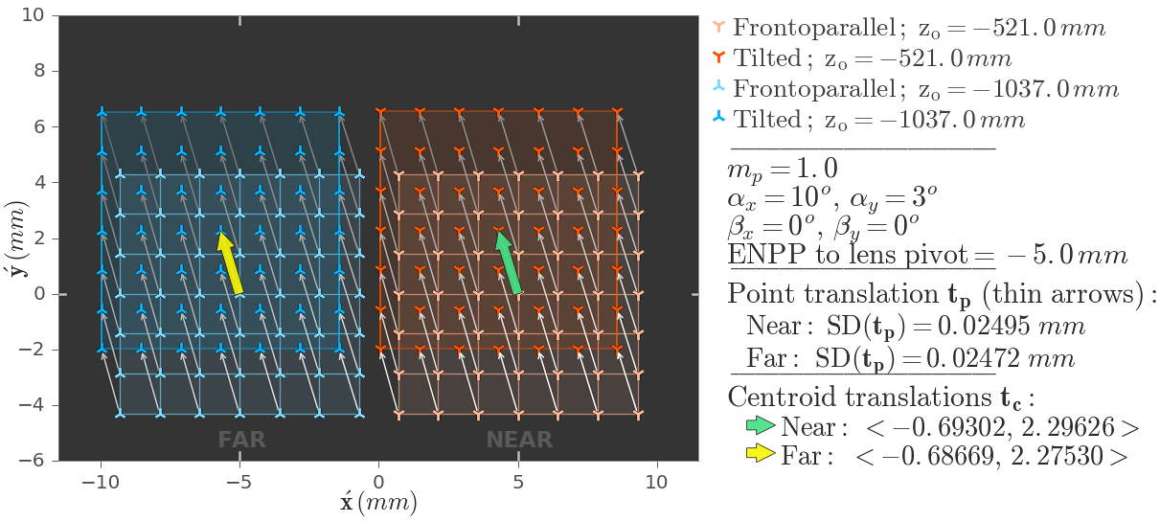
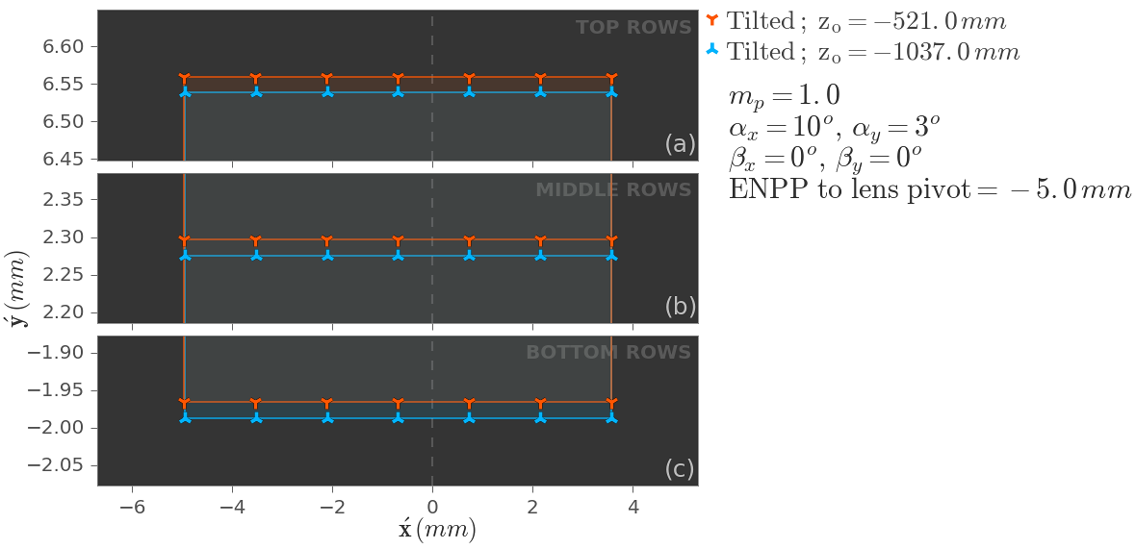
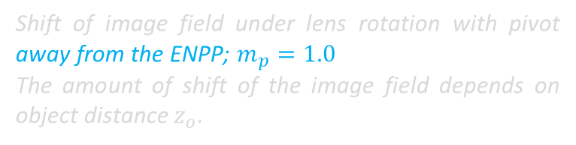
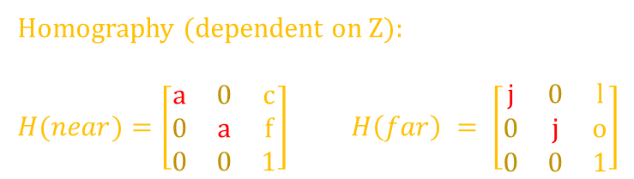
Geometric image under lens rotation. Pivot $≠$ ENPP
Shift of image field under lens rotation with pivot away from the ENPP; $m_{p}=1.0$
The amount of shift of the image field depends on object distance $z_{o}$.
The top, middle and bottom rows of the grid of dots images. The difference in the shift of the three rows implies that the distortion is NOT independent of object distance. i.e. lens rotation away from the ENPP introduces parallax.
Homography (dependent on Z):
$H(near)=\left[\begin{matrix}a & 0 & c \\ 0 & a & f \\ 0 & 0 & 1\end{matrix}\right]$ $H\left(far\right) = \left[\begin{matrix}j & 0 & l \\ 0 & j & o \\ 0 & 0 & 1\end{matrix}\right]$
Notes:
Example homography (dependent on Z):
$$H(near)=\left[\begin{matrix}0.9913 & 0 & −0.6930 \\ 0 & 0.9913 & 2.2963 \\ 0 & 0 & 1\end{matrix}\right]$$
$$H\left(far\right) = \left[\begin{matrix}0.9914 & 0 & −0.6867 \\ 0 & 0.9914 & 2.2753 \\ 0 & 0 & 1\end{matrix}\right]$$

Slide 9

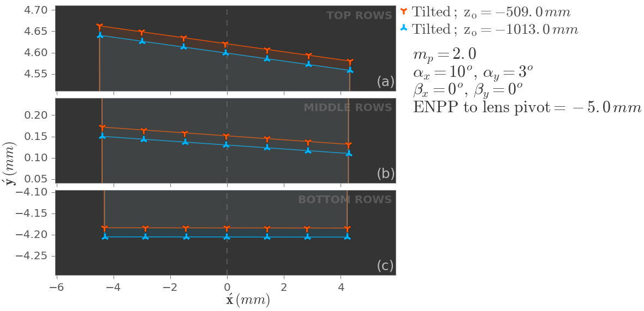
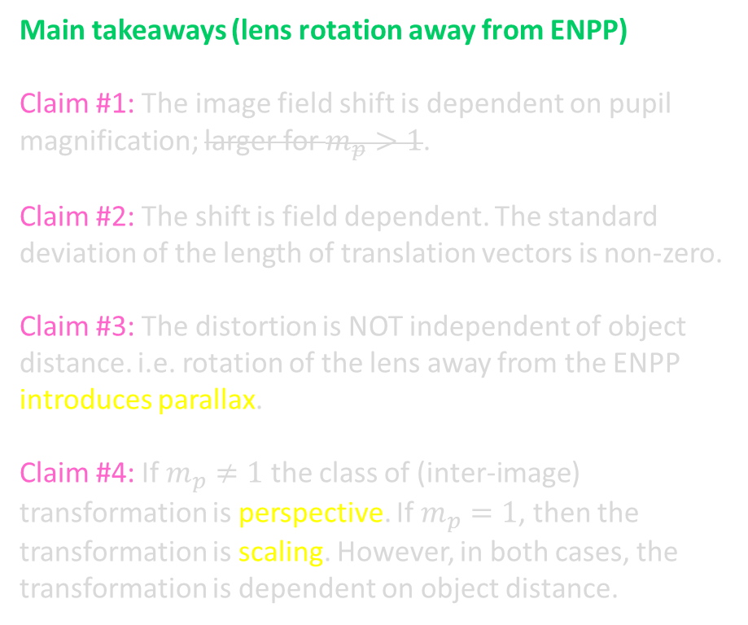

Geometric image under lens rotation. Pivot $≠$ ENPP
Figs: Shift of image field under lens rotation with pivot away from the ENPP; $m_{p}=2.0$
Main takeaways (lens rotation away from ENPP)
Claim #1: The image field shift is dependent on pupil magnification; larger for $m_{p}>1$.
Claim #2: The shift is field dependent. The standard deviation of the length of translation vectors is non-zero.
Claim #3: The distortion is NOT independent of object distance. i.e. rotation of the lens away from the ENPP introduces parallax.
Claim #4: If $m_{p}≠1$ the class of (inter-image) transformation is perspective. If $m_{p}=1$, then the transformation is scaling. However, in both cases, the transformation is dependent on object distance.

Slide 10
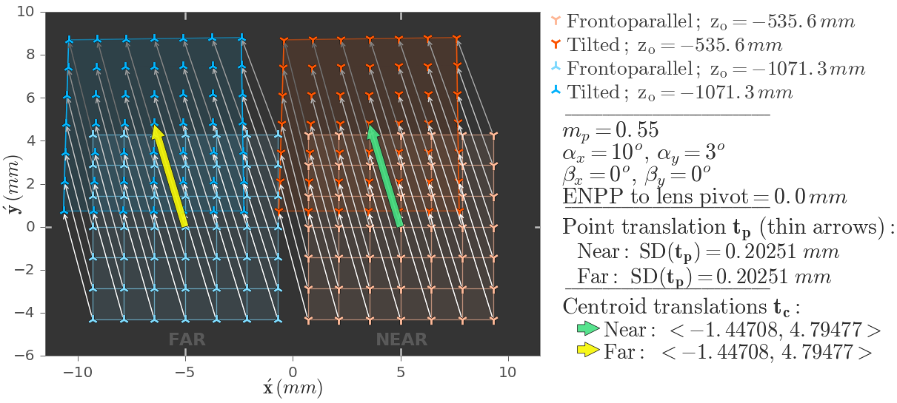
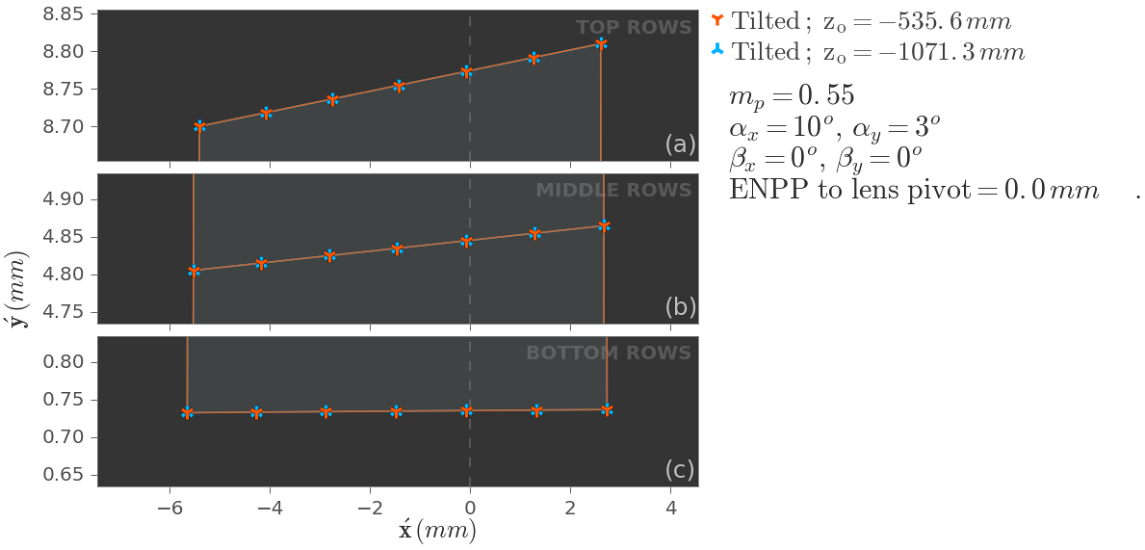
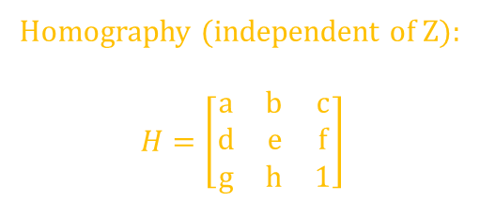
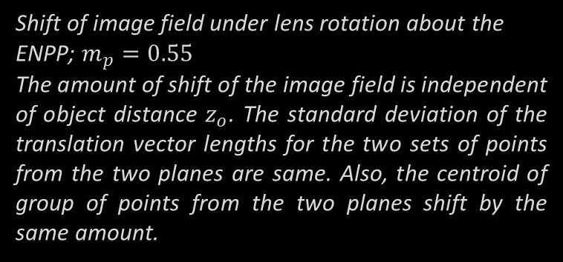
Geometric image under lens rotation. Pivot $=$ ENPP
Shift of image field under lens rotation about the ENPP; $m_{p}=0.55$
The amount of shift of the image field is independent of object distance $z_{o}$. The standard deviation of the translation vector lengths for the two sets of points from the two planes are same. Also, the centroid of group of points from the two planes shift by the same amount.
The top, middle and bottom rows of the grid of dots images of the two planes. The three rows shift exactly by the same amount in each direction implying that the distortion is independent of object distance.
Homography (independent of Z):
$$H=\left[\begin{matrix}a & b & c \\ d & e & f \\ g & h & 1\end{matrix}\right]$$
Notes:
Example homography (independent of Z):
$$H=\left[\begin{matrix}0.9552 & −0.0007 & −1.4591 \\ −0.0007 & 0.9552 & 4.8345 \\ −0.0016 & 0.0052 & 1\end{matrix}\right]$$
Self note: For the examples that I have considered till now, for reasons that I don’t understand yet, the entries $b$ and $d$ seems to be equal. This behavior doesn’t change if I change the order of elementary rotations.

Slide 11
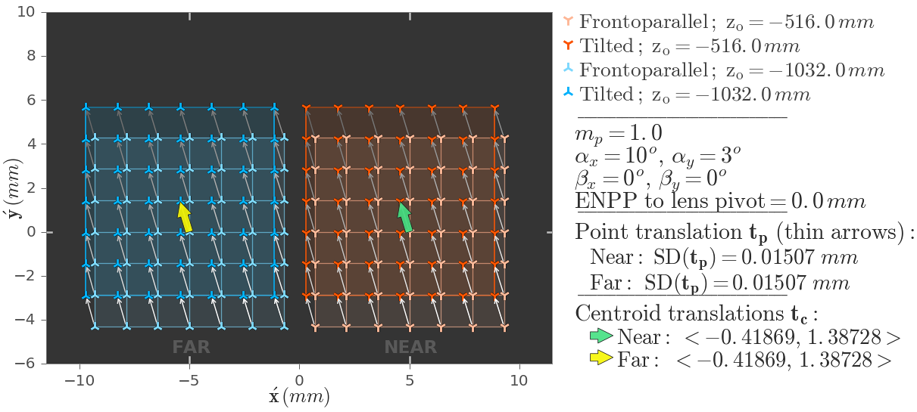
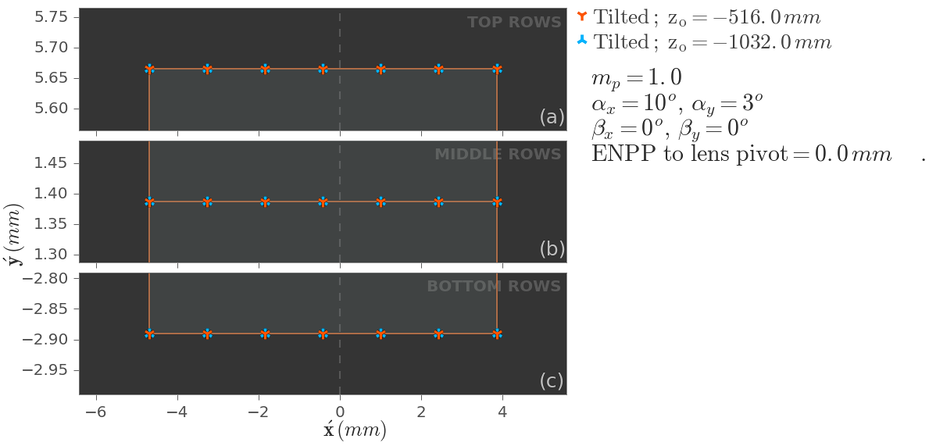
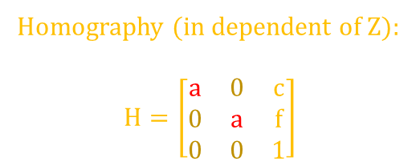
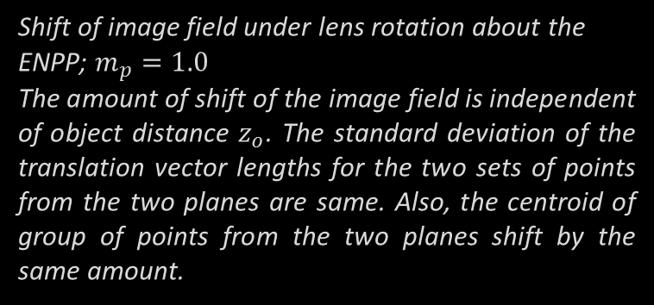
Geometric image under lens rotation. Pivot $=$ ENPP
Shift of image field under lens rotation about the ENPP; $m_{p}=1.0$
The amount of shift of the image field is independent of object distance $z_{o}$. The standard deviation of the translation vector lengths for the two sets of points from the two planes are same. Also, the centroid of group of points from the two planes shift by the same amount.
The top, middle and bottom rows of the grid of dots images of the two planes. The three rows shift exactly by the same amount in each direction implying that the distortion is independent of object distance.
Homography (in dependent of Z):
$$H=\left[\begin{matrix}a & 0 & c \\ 0 & a & f \\ 0 & 0 & 1\end{matrix}\right]$$
Notes:
Example homography (in dependent of Z):
$$H=\left[\begin{matrix}0.9947 & 0 & −0.4187 \\ 0 & 0.9947 & 1.3873 \\ 0 & 0 & 1\end{matrix}\right]$$

Slide 12
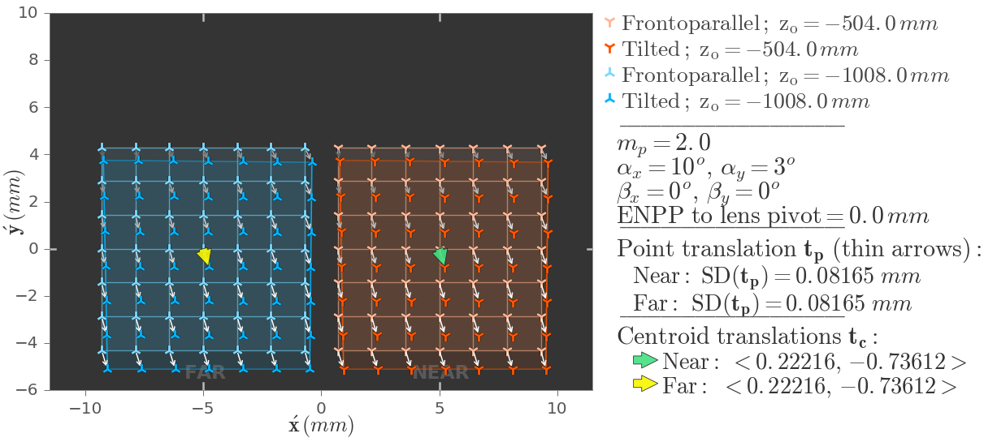
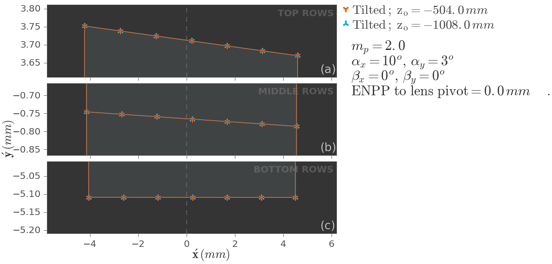
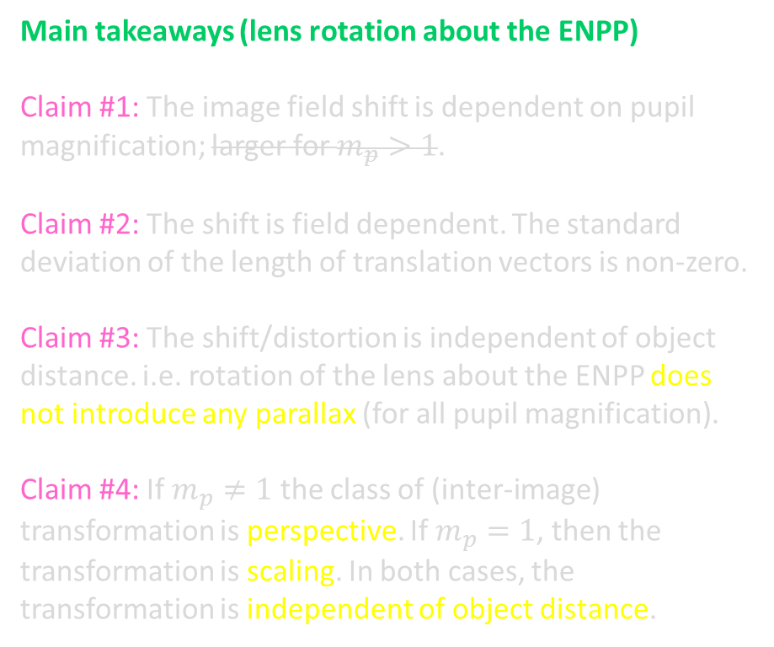
Geometric image under lens rotation. Pivot $=$ ENPP
Main takeaways (lens rotation about the ENPP)
Claim #1: The image field shift is dependent on pupil magnification; larger for $m_{p}>1$.
Claim #2: The shift is field dependent. The standard deviation of the length of translation vectors is non-zero.
Claim #3: The shift/distortion is independent of object distance. i.e. rotation of the lens about the ENPP does not introduce any parallax (for all pupil magnification).
Claim #4: If $m_{p}≠1$ the class of (inter-image) transformation is perspective. If $m_{p}=1$, then the transformation is scaling. In both cases, the transformation is independent of object distance.

